Slide 1
Making Natural Capital data meaningful
Lisa Norton
lrn@ceh.ac.uk

Slide 2

Where CEH science sits:
Natural capital assets
location
properties
functions
Actions/driving forces
CEH
Service provision
management
restoration
creation
provisioning
regulating
cultural
supporting
Other capital
manufactured
financial …
Societal response
policy
incentives
opinions
responsibilities
Human well-being
benefits
values

Slide 3

CEH Natural Capital Science area
Status of natural capital
How natural capital is changing
Causes of change
Sustainable levels of use
Management and restoration
All underpinned by data

Slide 4
CEH datasets
Countryside Survey
Biological Records Centre
Site based data – e.g. ECN, NRFA,
Lakes, Atmospheric monitoring

Slide 5
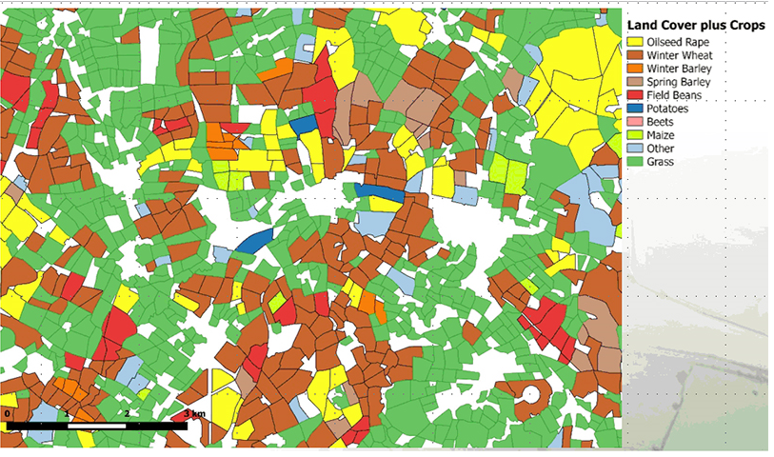
CS – LCM – low resolution, but everywhere
LCM 2007 – LCM 2000 – LCM 1990
Coming soon
LCM 2015
Already here – the 2015 (2016) crop map
Land Cover Map

Slide 6
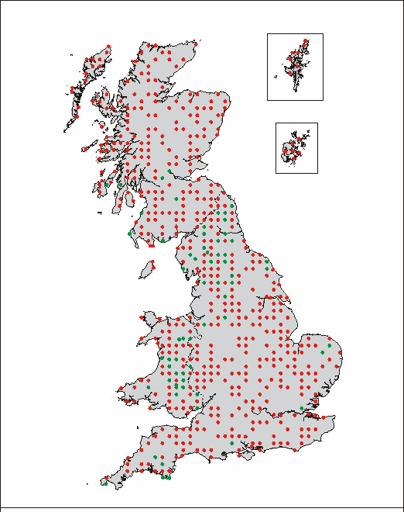
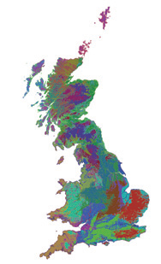
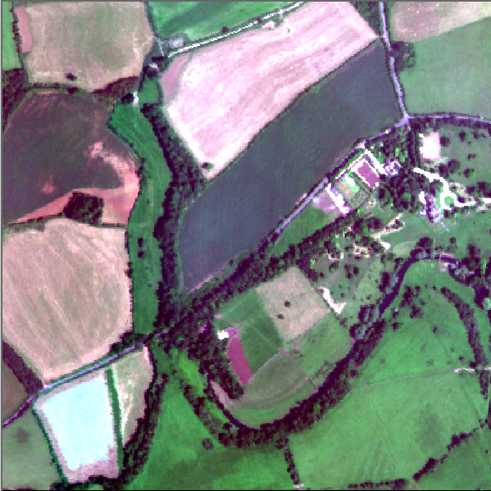
CS - Field Survey – high resolution, sample
Countryside Survey, designed for measuring extent and condition of GB natural capital
45 environmental strata – GB (England, Wales and Scotland)
stratified
random sample
Surveys: 1978, 1984, 1990, 2000, 2007, ?
  Based on 40 underlying variables gleaned from OS data on climate, soils, topography and geology classified using PCA to give 45 land classes across Great Britain
Notes:
256 – 8 per land class
384 – 12 per land class
508 – ~16 per land class

Slide 7
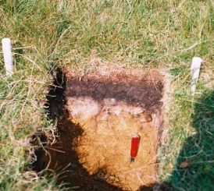
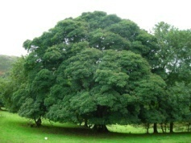
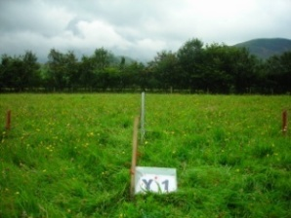
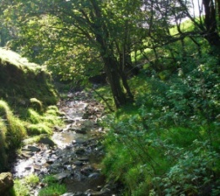
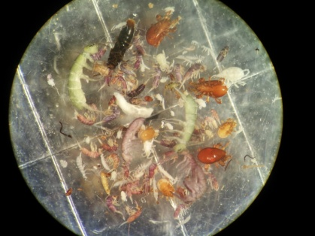

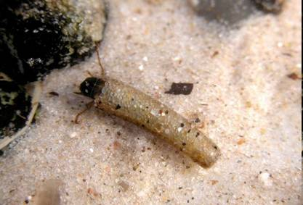
CS – Integrated monitoring
Habitats and landscape features
Soil profiles
Soil and water chemistry
Land use
Plant and invertebrate (soil and water) species
Integrated monitoring
(habitats, vegetation, landscape features, soils and water)
For understanding relationships between variables
and patterns of change.
Notes:
Widespread Broad Habitats, e.g. Neutral Grassland, Broad leaved Woodland
Extensive Priority Habitats, e.g. Blanket Bog, hedges
Other habitats, e.g. Individual trees, ponds
Large areas of Broad Habitats
Small patches of habitat
Linear features (e.g. Roads, hedges, streamsides)
Ponds and headwater streams
.

Slide 8

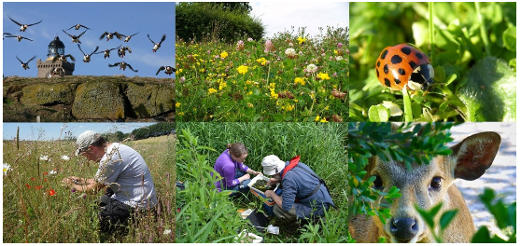
Biological Records Centre– volunteer recording
56% of UK species declined since
1970
More than 1/10 at threat of
disappearance from UK
1, 600 annual indices BRC
1,300 plants recorded in CS

Slide 9
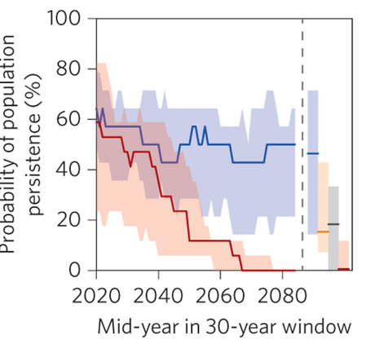
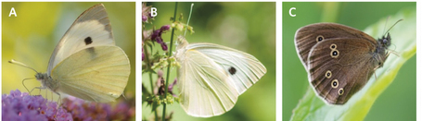
BMS data –understanding species change
60 butterfly species recorded
(includes habitat information)
Managing landscapes (e.g. reducing habitat fragmentation), increases probability of butterfly persistence from around zero to between 6 and 42%
Oliver et al. (2015). Nature Climate Change

Slide 10

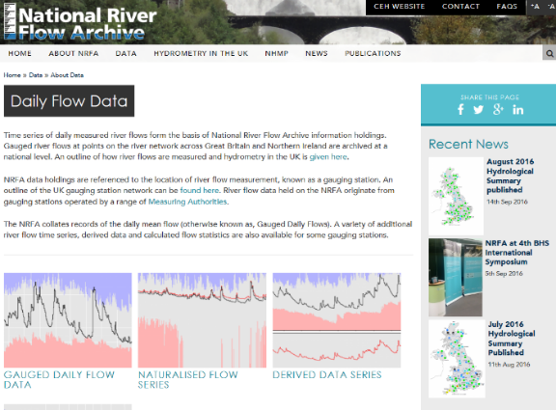
Site based data – for process understanding (1)
1. Integrated monitoring, atmosphere, land and water at ECN sites
2. Recording of natural capital that changes continuously e.g. river flows

Slide 11

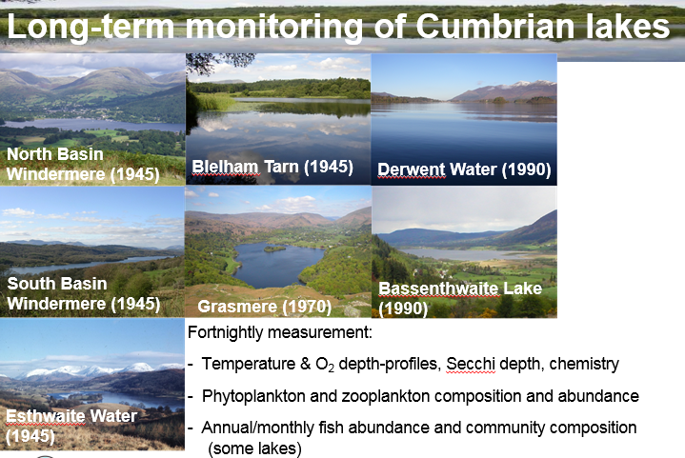
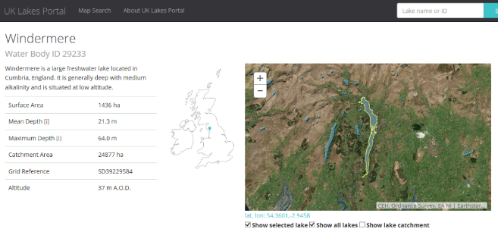
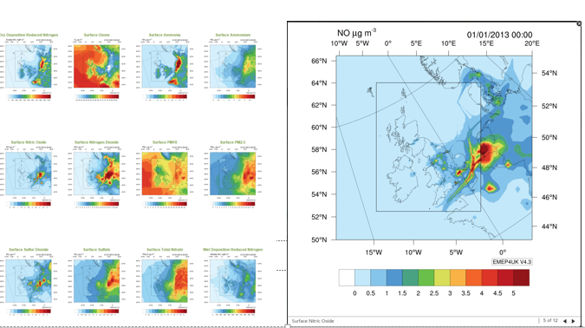
Site based data – for process understanding (2)
3. Lakes monitoring – sentinels of the environment – long term highly resolved regular monitoring
Lakes portal
4. Atmospheric data Monthly/daily/ annual averages for pollutants (such as NOx, NH₄, Ozone)
Notes:
Maps are already available on a website

Slide 12


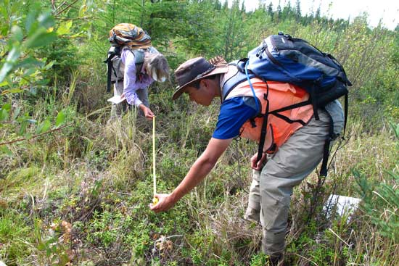

Consolidating and streamlining data
Earth observation
Environmental sensors
Efficient targeted field surveys
Citizen science

Slide 13
Making data meaningful

Slide 14

Natural capital metrics
Natural capital assets
butterflies
trees
grasses
birds
fish
microbes
soil structure
river water quality
river flow
NO_{x}
PM₁₀
…….
Human well-being
food
timber
clean air
recreation
aesthetic quality
landscape
equitable climate
…….
New metrics
Based on data sets and understanding of ecosystem processes and functions
Land cover types
woodland
heath
peatland
freshwaters
urban
farmland
estuaries
hedges
…….
and condition
Direct links

Slide 15
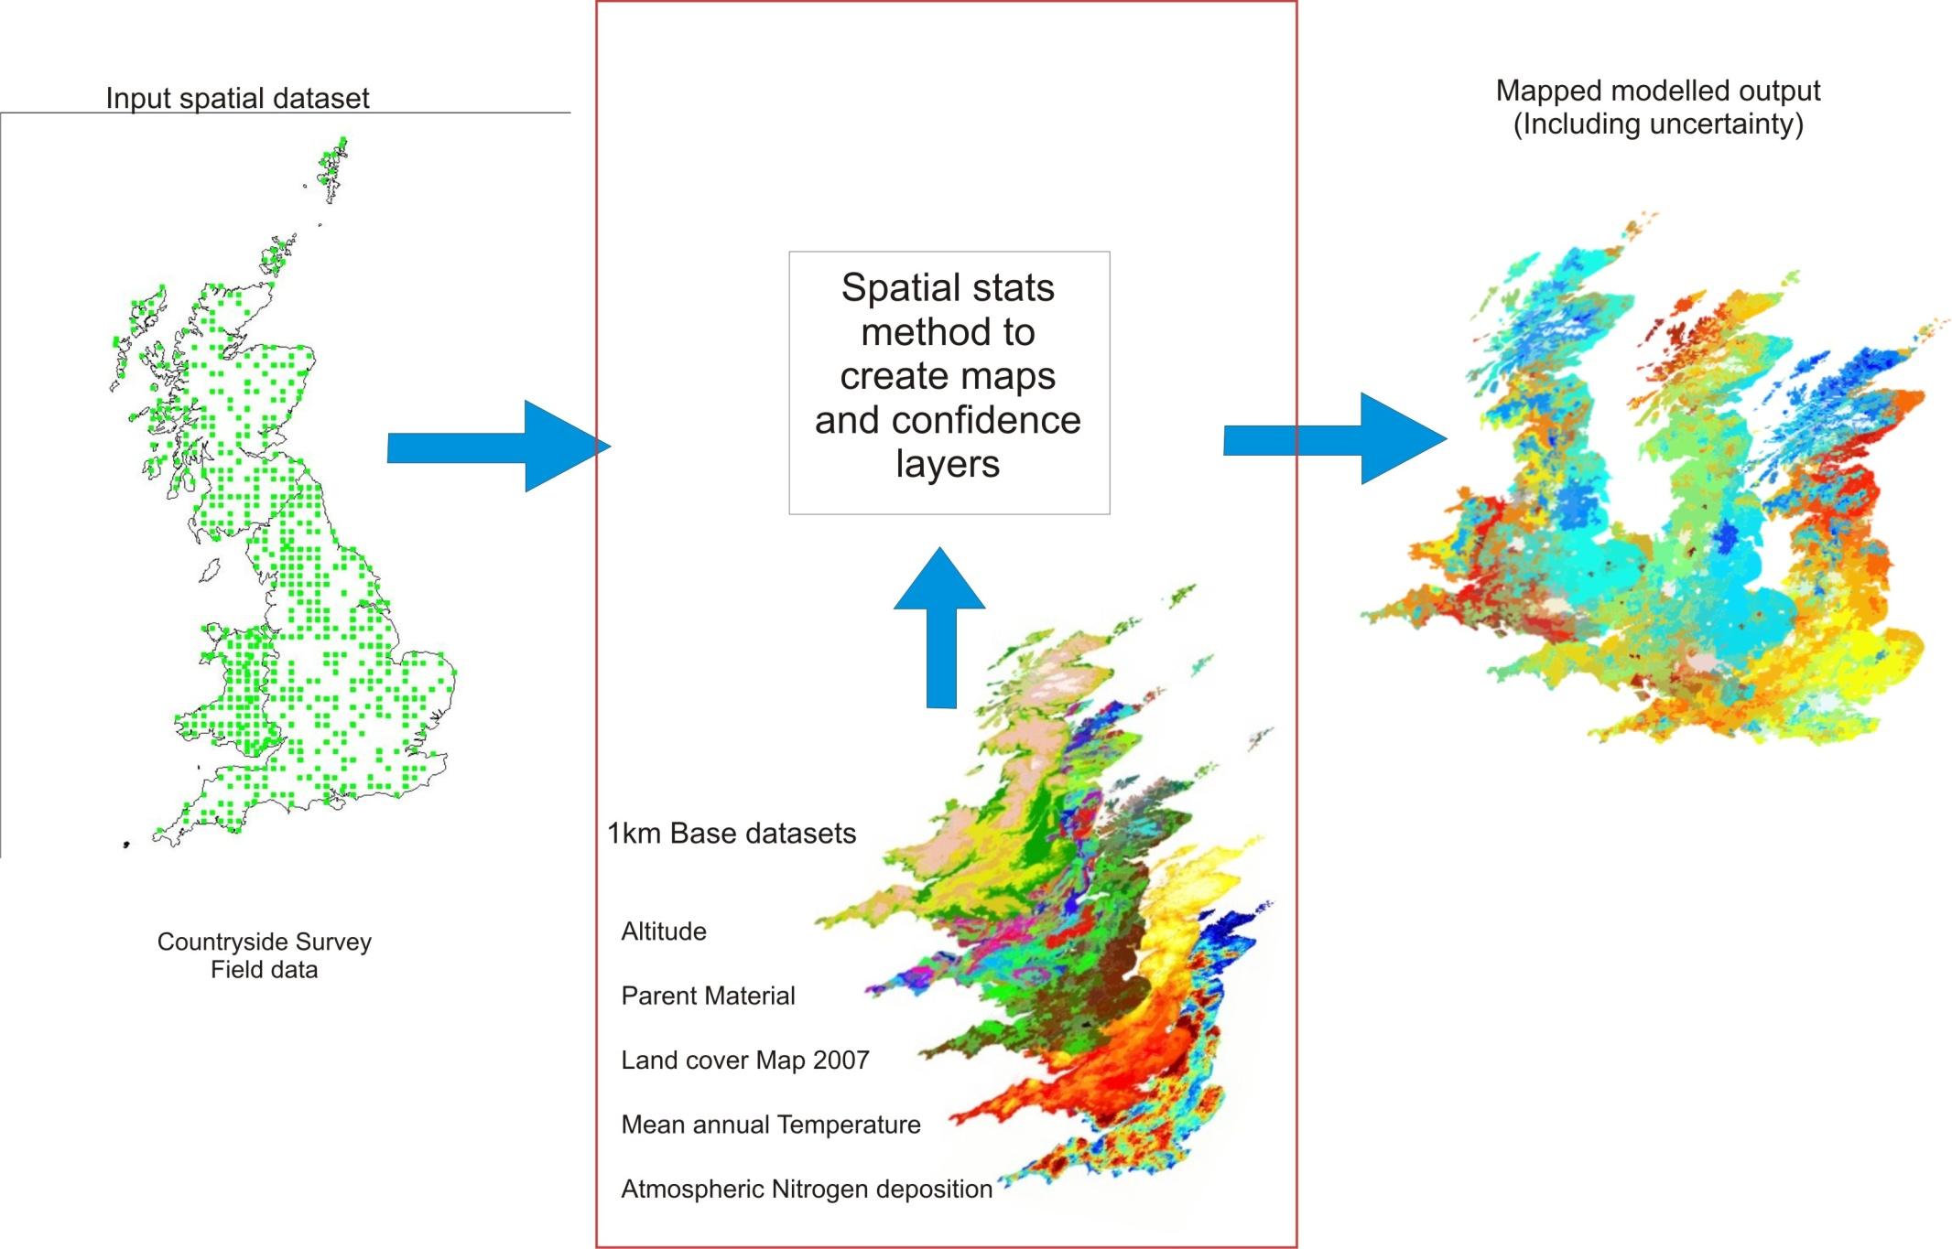

Beyond data sets
1. Developing and applying tools and models to produce natural capital metrics which can be linked to measures of well-being at national scales.
2. Identifying and providing an evidence base for the steps in the chain between natural capital assets and the provision of ecosystem goods e.g. experiments, case studies, systematic reviews

Slide 16
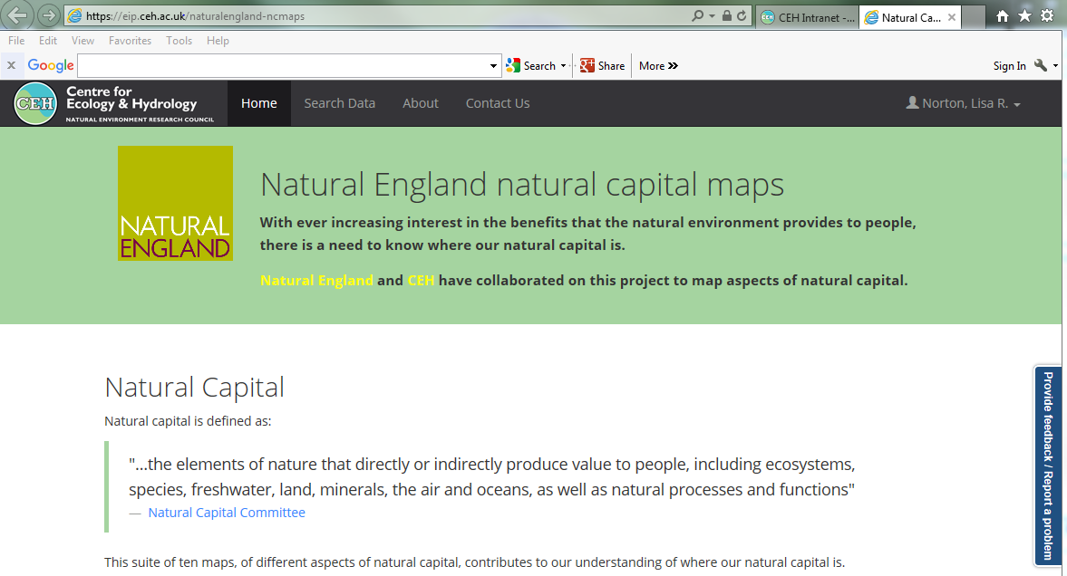
Natural capital mapping for policy

Slide 17
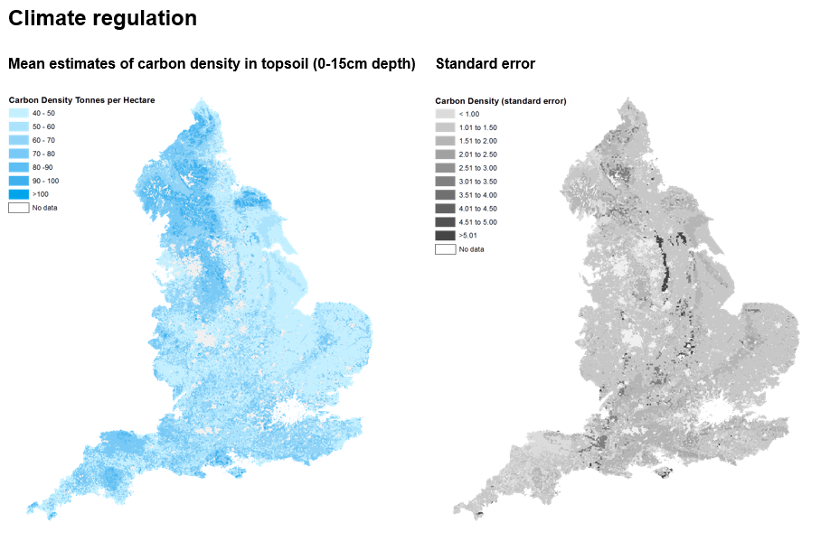

Soil Carbon – a metric relevant to climate regulation
Henrys et al. (2015) Ecography 38, 632-638
Model covariates
habitat type (CS and LCM)
soil parent material (BGS)
Notes:
From Loss on Ignition and Bulk Density data for X plots in CS squares

Slide 18
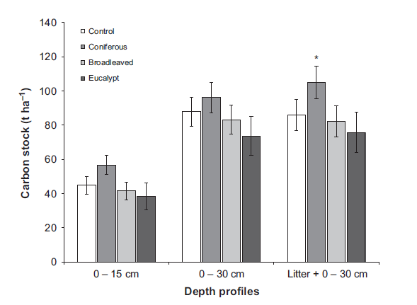
Other relevant work
Exploring integration of EO products with field data to produce NC variables, e.g. productivity
Optimising field measures e.g. soil core depths
Identifying habitat condition metrics
Exploring the effects of scaling down national statistics to local levels
Consolidating NC metrics across datasets

